Slide 1
1. Connect
2. Git
3. Docker
4. Kubernetes
5. CI/CD
6. Misc

Slide 2

Kubernetes (also known as k8s or “kube”) is an open source container orchestration platform that automates many of the manual processes involved in deploying, managing, and scaling containerized applications

Slide 3
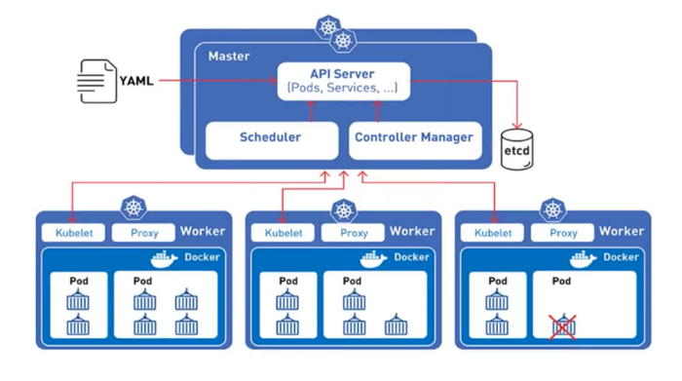
Design
- Masters
- Nodes
- Api
- Yaml
- Kubelet
- Proxy
Ref

Slide 4

API first
There are 2 ways to communicate with Kubernetes
- API*
- Kubectl (api translator)
*API is the acronym for Application Programming Interface, which is a software intermediary that allows two applications to talk to each other. Each time you use an app like Facebook, send an instant message, or check the weather on your phone, you're using an API.

Slide 5
1. Connect
2. Git
3. Docker
4. Kubernetes
5. CI/CD
6. Misc

